Slide 1
Matching the specialist knowledge with requirements
SUBMITTED BY:-
ABHINAV JAIN (2814176)
BRIJESH KHANIJO (2814188)
RIJU JAIN (2814164)

Slide 2
The Perfect Work
The main objective of this project is to enhance work quality and efficiency by hiring specialized workers.
The project can be named as “Matching the specialist knowledge with requirements”.
With the simple user interface, the people has a feature to locate the specialized person in their nearby location.

Slide 3
TOOLS USED
Tools used in this project are:-
1.JAVA SERVLETS
2. JAVA SERVER PAGES
3.ORACLE
4.NET BEANS IDE 8.0

Slide 4
OUTPUT:-

Slide 5
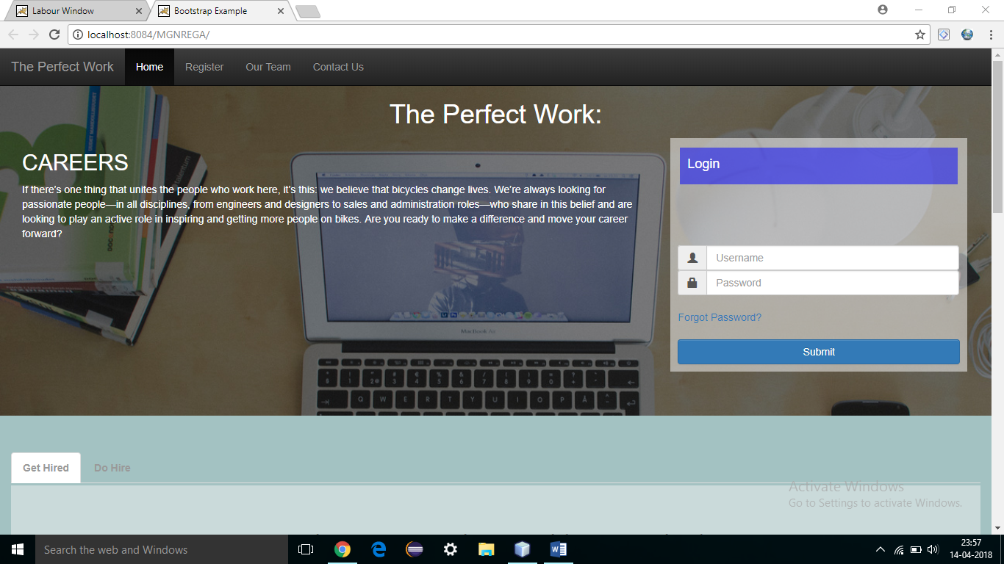
1.Home Page

Slide 6
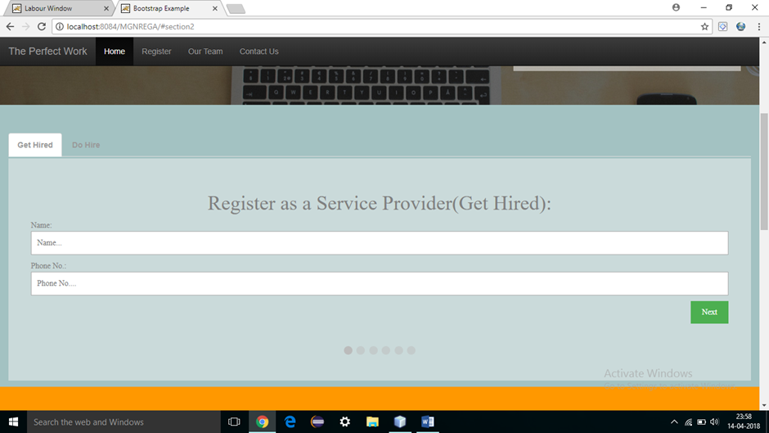
2. Register(Name):

Slide 7
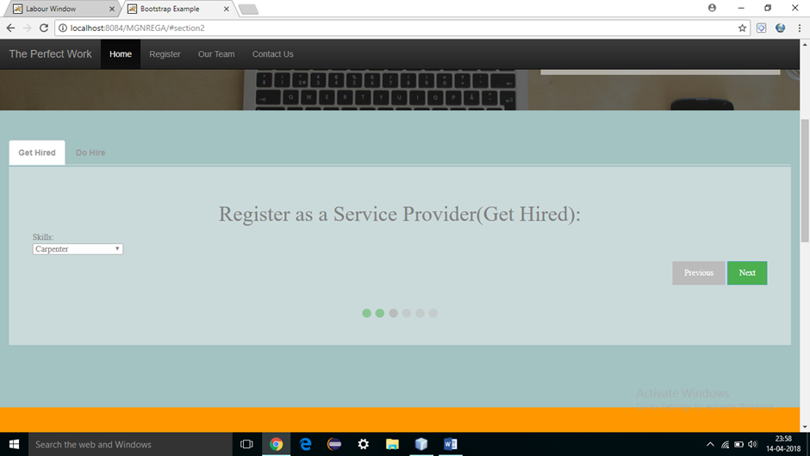
3. Select Work:

Slide 8
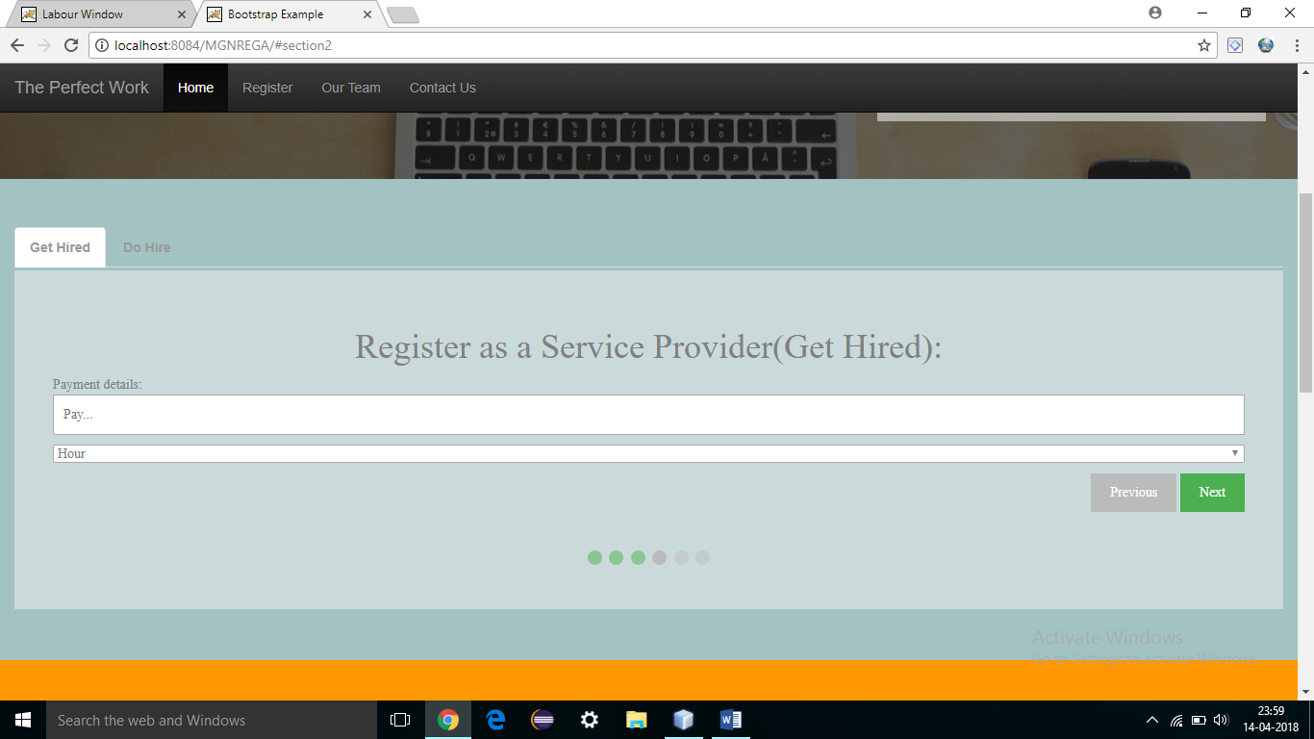
4.Payment Details:

Slide 9
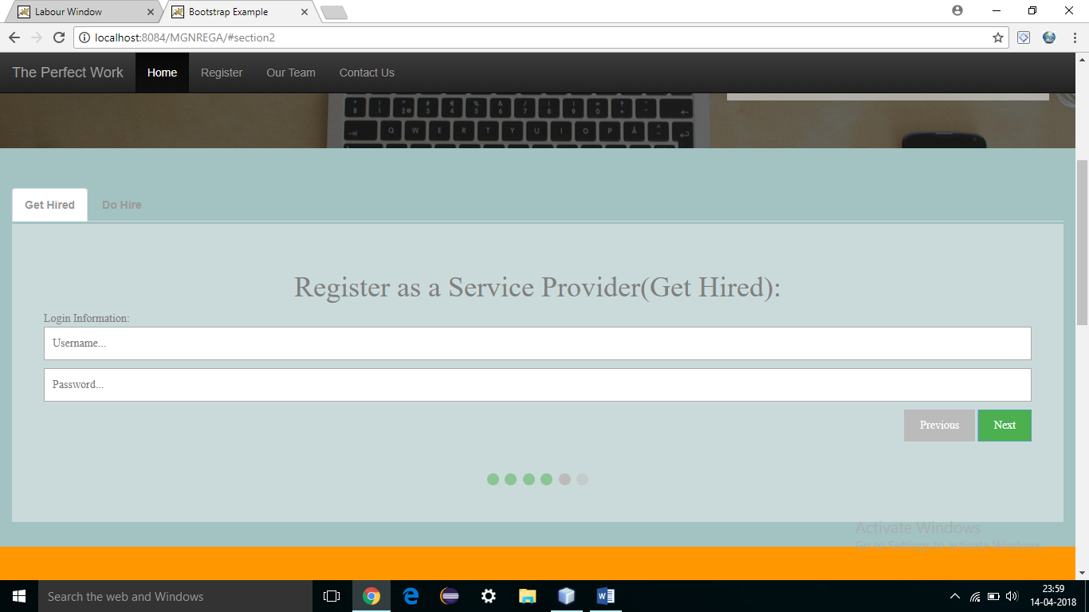
5. Register(username & password)

Slide 10
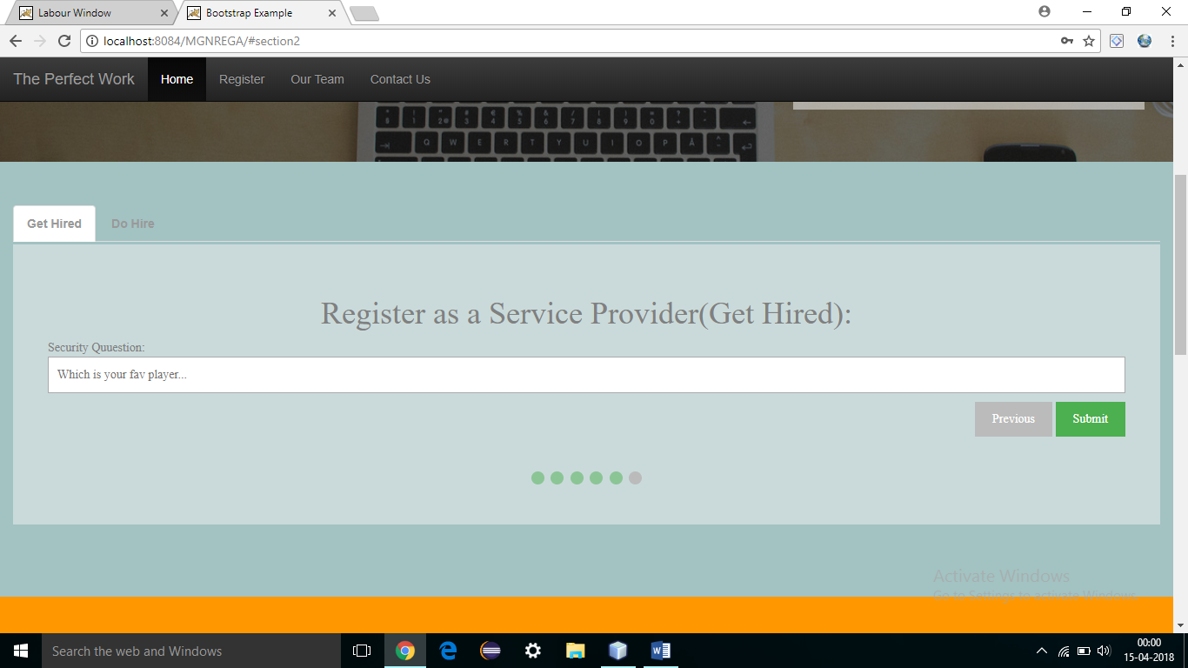
6.Security Question:

Slide 11
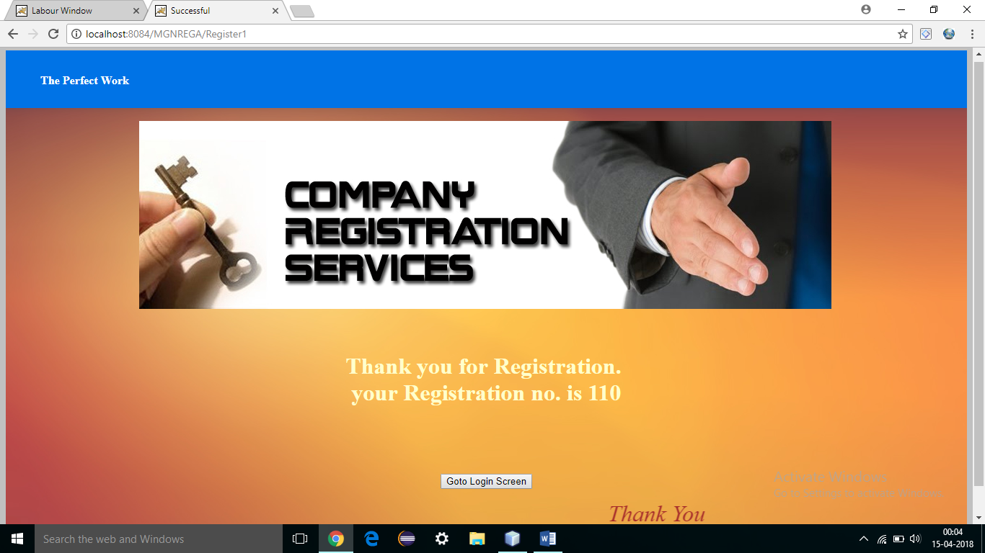
7. Registration complete

Slide 12
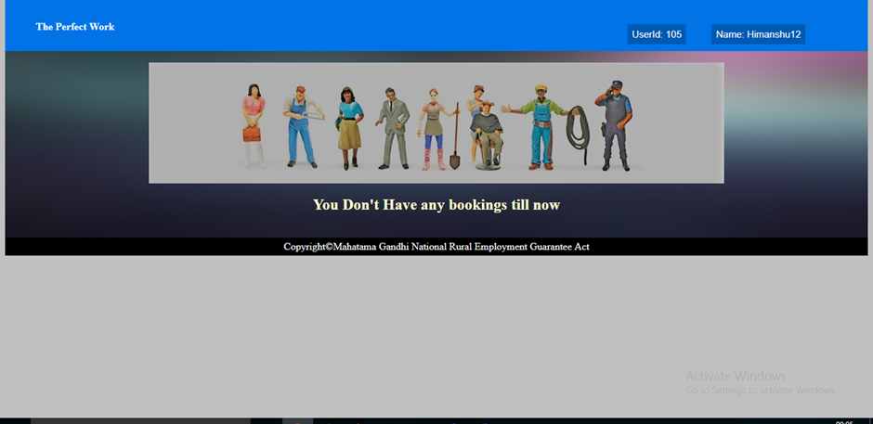
8.User Window

Slide 13
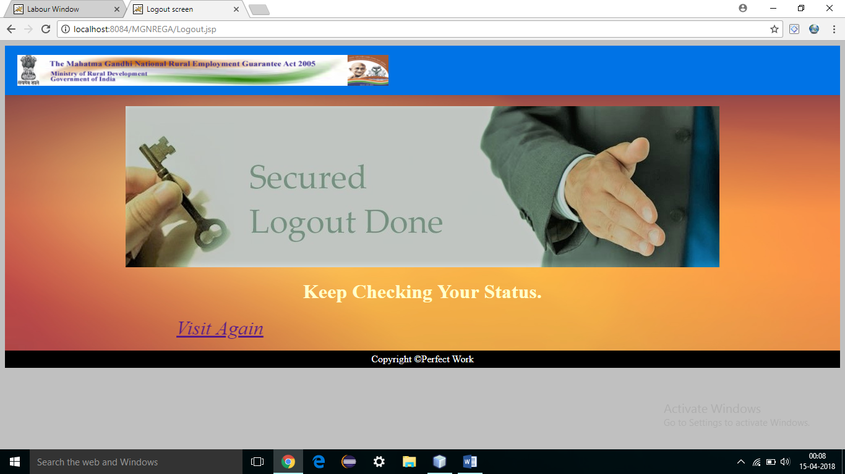
9.Logout frame

Slide 14
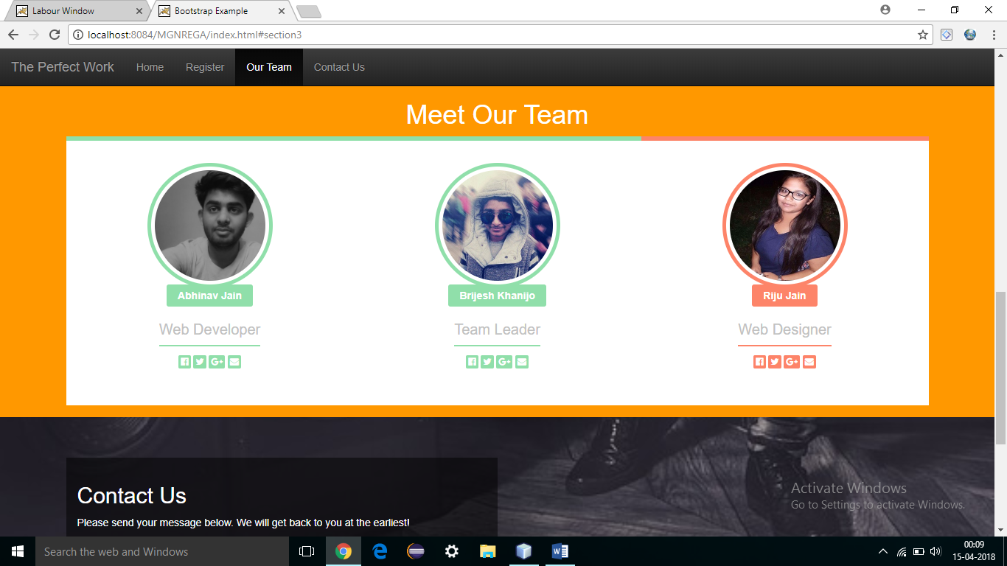
10.Meet our team

Slide 15
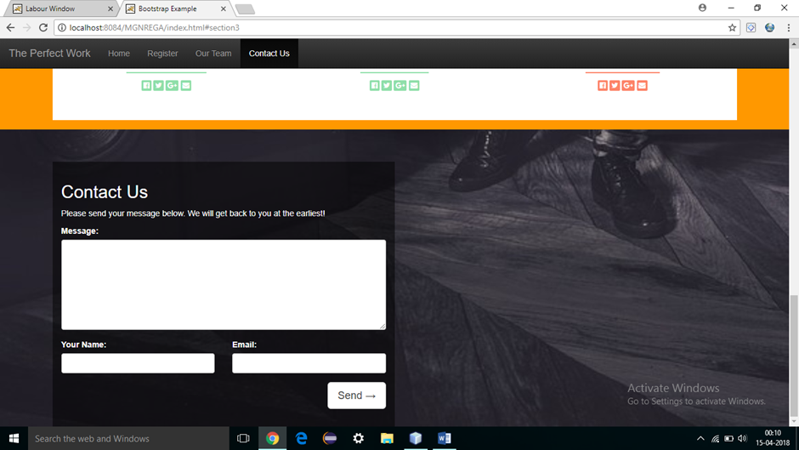
11.Contact Us

Slide 16
THANK YOU

